Slide 1
Angular
Architecture
Lecture 1
By James(Jin) Wang
09/01/2019

Slide 2
Outline
Components and their Templates
Template Syntax including Data binding
Services using Dependency Injection
Routing
HTTP and Data
Observability with RxJS
How Angular Modules help organize code

Slide 3
Big Picture
  Overview:
  Language Choices
  Angular 1’s Impact
  Comparing Concepts from Angular 1 to 2
  Resources

Slide 4
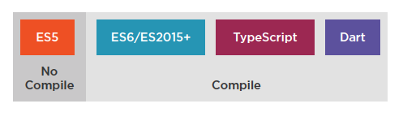
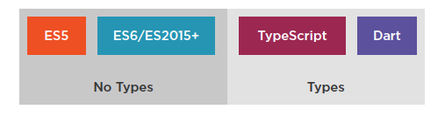
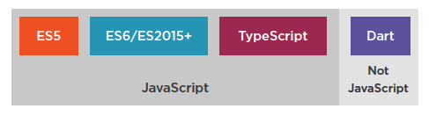
Language Choices

Slide 5
Angular 1 to Angular 2
  7 Key Comparisons:
  Angular Modules
  Controllers to Components
  Structural Built-In Directives
  Data Binding
  Remove the Need for Many Directives
  Services
  Dependency Injection

Slide 6
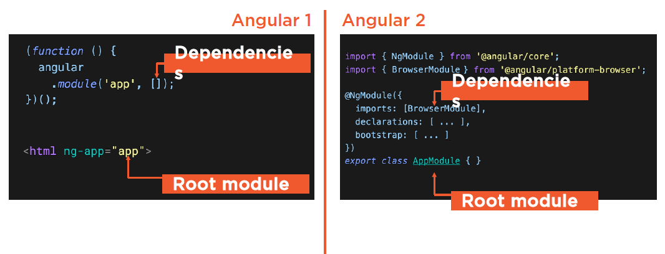
Angular Modules

Slide 7
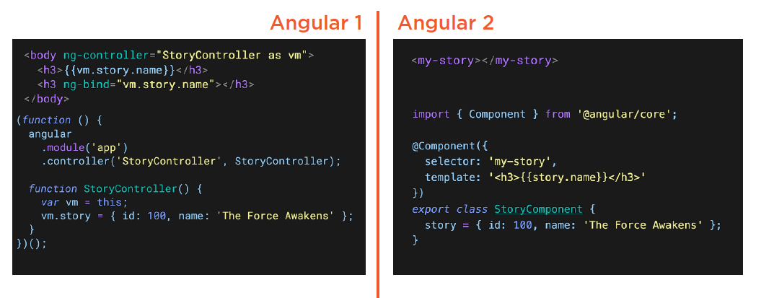
Controllers to Components

Slide 8
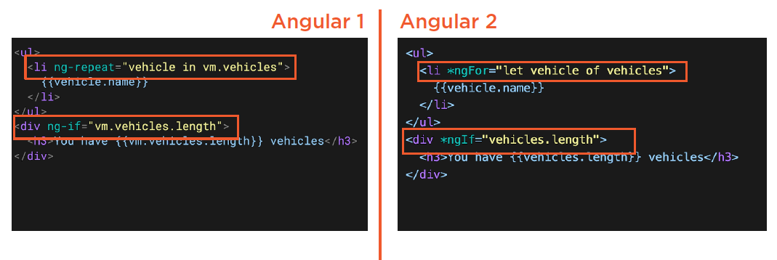
Structural Built-In Directives

Slide 9
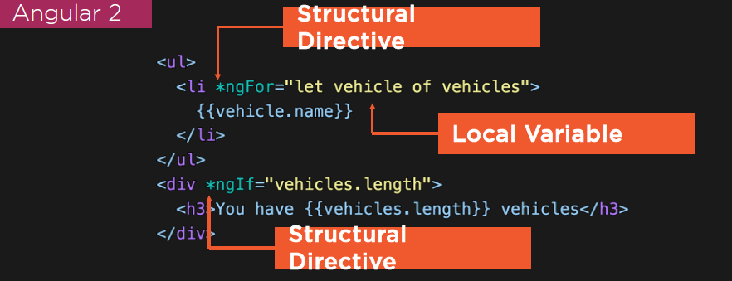
Structural Built-In Directives
  Structural Directives:
  Indicated by the * prefix
  Changes the structure

Slide 10
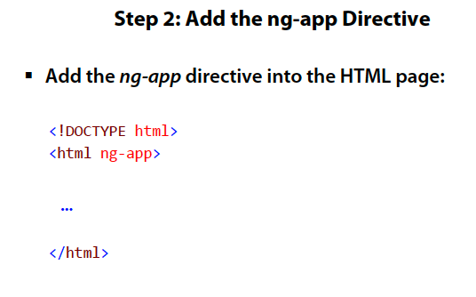
Big Picture

Slide 11
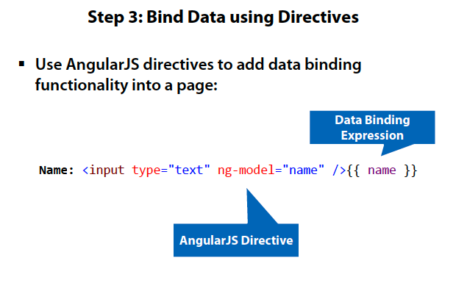
Big Picture
  AJS Demo: HelloWorld

Slide 12
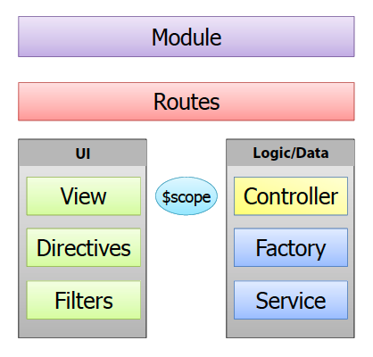
Big Picture
  Key Players in AngularJS:

Slide 13
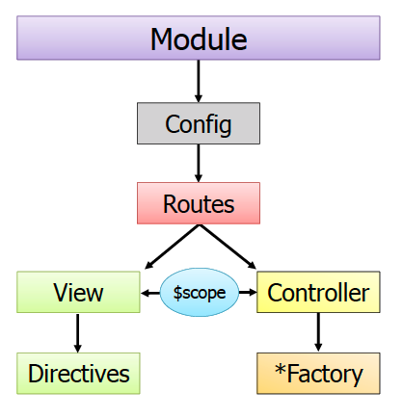
Big Picture
  The Big Picture:

Slide 14
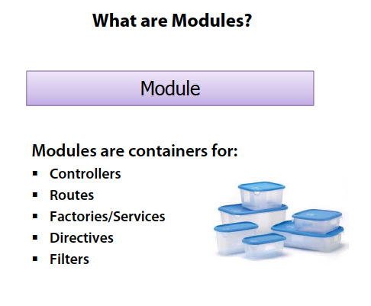
Big Picture

Slide 15
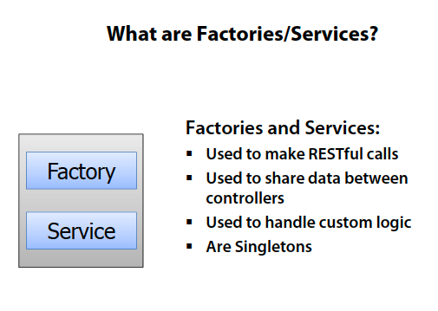
Big Picture

Slide 16
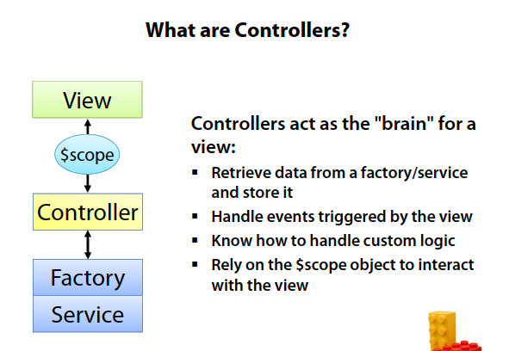
Big Picture

Slide 17
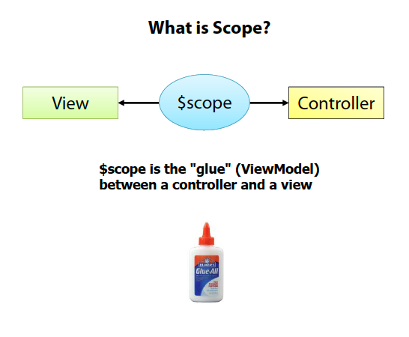
Big Picture

Slide 18
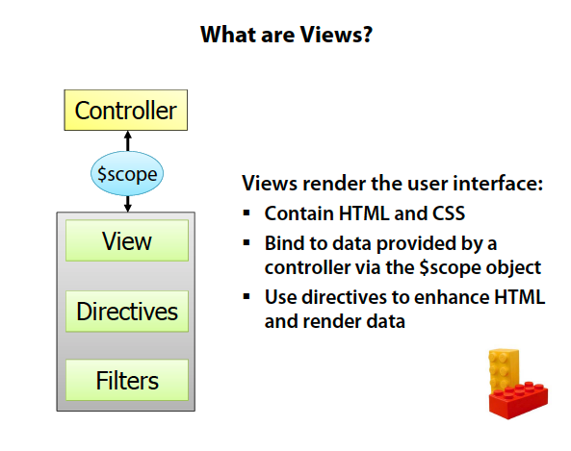
Big Picture

Slide 19
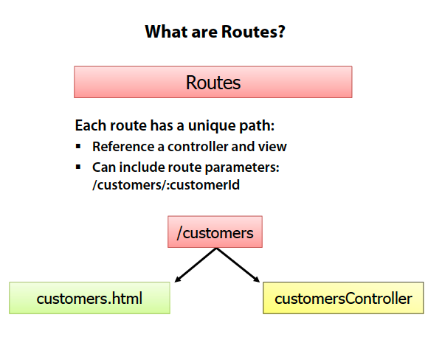
Big Picture

Slide 20

Big Picture
  https://docs.angularjs.org/api

Slide 21
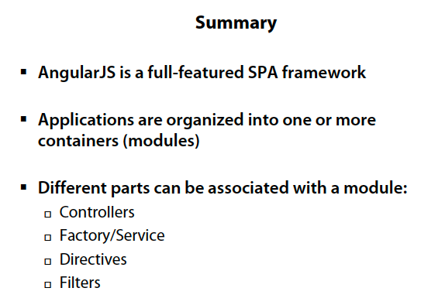
Big Picture

